Slide 1
Chapter 2
Dealing with different types of data

Slide 2
Terminologies in Data Analytics
Dealing with Different Types of Data
Introduction, Terminologies in Data Analytics, Text analytics, web analytics, marketing analytics, Types of Data –Data, numerical data and categorical data, structured and unstructured data, ordinal data and nominal data, data types, and data format, types of data repositories such as Databases, Data Warehouses, Data Marts, Data Lakes, and Data Pipelines.

Slide 3
Terminologies in Data Analytics
Artificial intelligence (AI) is a simulation of human intelligence processes by machines. It combines computer science with robust datasets to enable problem solving using the rapid learning capabilities of machines.
Augmented intelligence is a design pattern for a human-centered partnership model of people and artificial intelligence used to enhance cognitive performance, including learning, decision making, and new experiences. The combination of human intuition and artificial intelligence is powerful and can help mitigate perceived risk with purely machine-driven AI.
Big data refers to large and complex datasets containing structured and unstructured data, arriving in increasing volumes and velocity. Big data is relative — what was big ten years ago is no longer considered big today, and the same will be true ten years from now. The point here is that the data is big enough to require special attention with regards to storing, moving, updating, querying, and aggregating it.

Slide 4
Terminologies
Business glossary is a repository of information that contains concepts and definitions of business terms frequently used in day-to-day activities within an organization — across all business functions — and is meant to be a single authoritative source for commonly used terms for all business users.
Business intelligence (BI) leverages software and services that help business users make more informed decisions by delivering reports and dashboards to help them analyze data and actionable information.

Slide 5
Terminologies in Data Analytics
Cloud computing is a service provided via the internet where an organization can access on-demand computing resources from another organization under a shared service model. Cloud computing allows organizations to avoid large upfront costs and ongoing maintenance associated with procuring, hosting, and managing their own data centers. Users can effectively rent compute, network, and storage resources for a period and only pay for the services as long as they are using them. This allows for maximum flexibility to scale up and scale down resources quickly and on-demand.
Data architecture is the plan and design for the entire data lifecycle for an organization, starting when data is captured, going all the way to when value is generated from data through analytics.
Data catalog is the pathway — or a bridge — between a business glossary and a data dictionary. It is an organized inventory of an organization’s data assets that informs users — both business and technical — on available datasets about a topic and helps them to locate it quickly.
Data democratization is the process of providing all business users with an organization — technical and non-technical — access to data and enabling them to use it, when they need it, to gain insights and expedite decision-making.

Slide 6
Terminologies in Data Analytics
Data dictionary is the technical and thorough documentation of data and its metadata within a database or repository. It consists of the names of fields and entities, their location within the database or repository, detailed definitions, examples of content, descriptions for business interpretation, technical information like type, width, constraints, and indexes, and business rules and logic applied to derived or semantic assets.
Data engineering is the process and practices needed to transform raw data into meaningful and actionable information. Common data engineering tasks involve data collection, extraction, curation, ingestion, storage, movement, transformation, and integration.
Data ingestion is the process by which data is loaded from various sources to a storage medium — such as a data warehouse or a data lake — where it can be accessed, used, and analyzed.
Data integration is the process of connecting disparate data together for analysis or operational uses.

Slide 7
Terminologies in Data Analytics
Data governance is the way an organization ensures that its data policies, practices, and processes are followed. When executed properly, a governance program should also clearly define who ultimately owns the data, who stewards it when something needs to be corrected or maintained, and who uses it to ensure that downstream impacts of change are monitored.
Data lake is a central data repository that accepts relational, structured, semi-structured, and non-structured data types in a low-to-no modeling framework, used for tasks such as reporting, visualization, advanced analytics, and machine learning. A data lake can be established on premises (within an organization’s data centers) or in the cloud.

Slide 8
What is Text Analytics?
Text Analytics is a process of analyzing and understanding written or spoken language. It employs computer algorithms and techniques to extract valuable information, patterns, and insights from extensive textual data. In simpler terms, text analytics empowers computers to understand and interpret human language.
In simpler terms, text analytics helps computers understand and interpret human language. Here’s a real-world example to illustrate text analytics: Let’s say a company receives customer reviews for its products online. These reviews can be a goldmine of information, but it’s not feasible for humans to read and analyze thousands of reviews manually. This is where text analytics comes in. The text analytics system can automatically analyze the reviews, looking for patterns and sentiments. It can identify common words or phrases that customers use to express satisfaction or dissatisfaction. For example, it might recognize that words like love, great, and excellent often appear in positive reviews, while words like disappointed, issues, and poor may appear in negative reviews.

Slide 9
Why is Text Analytics Important?
Text analytics has become a crucial tool in today’s information age for two main reasons: the massive growth of text data and its unique ability to extract valuable insights hidden within that data.
1. Explosion of Text Data:
We generate an immense amount of text data daily, from emails and social media posts to customer reviews, documents, and online articles.
Traditional data analysis methods struggle with this unstructured format. Text data lacks the neat rows and columns of traditional databases.
Text analytics bridges this gap, allowing us to unlock meaning and value from this vast and ever-growing resource.
2. Uncovering Hidden Gems:
Text data is rich with information about people’s opinions, experiences, and behaviors.
By analyzing this data, we can discover hidden trends, patterns, and emotions that wouldn’t be readily apparent otherwise.
This can lead to significant benefits in various fields:
Businesses: Improved decision-making through understanding customer sentiment, identifying market trends, and optimizing marketing campaigns.
Research: Faster scientific discoveries by analyzing large volumes of research papers and uncovering hidden connections.
Society: Gaining a deeper understanding of social issues by analyzing public discourse on social media and identifying areas for improvement.

Slide 10
What Text Analytics Can Do?
Text analytics is a powerful tool that unlocks the meaning and value hidden within mountains of text data. It’s like having a super powered decoder ring for the vast amount of information we generate every day. Here are some of the key things text analytics can do:
Extracting Meaning from Text: Imagine sifting through mountains of emails, social media posts, or customer reviews. Text analytics can identify common themes, trends, and patterns within this data. It can reveal what people are talking about, the problems they’re facing, and the emotions they’re expressing.
Sentiment Analysis: Not all text is created equal. Text analytics can delve deeper and understand the emotions and opinions conveyed in the text. It can tell you if a customer review is glowing with praise or brimming with frustration. This allows businesses to gauge customer sentiment and satisfaction.

Slide 11
What Text Analytics Can Do?
Topic Modeling: Have a massive collection of documents or articles? Text analytics can uncover the hidden structure. Through topic modeling, it can identify the main subjects discussed within the text corpus. This is like automatically generating a detailed table of contents for a vast amount of information.
Entity Recognition: The world is full of people, places, and organizations. Text analytics can act like a super-powered highlighter, identifying these entities mentioned within text data. This can be incredibly useful for tasks like tracking mentions of a brand on social media or identifying key players in a research paper.
Text Classification: Sometimes you just need to sort things into piles. Text analytics can categorize text data into predefined groups. Imagine automatically classifying emails as spam or important, or sorting customer reviews by product category. This allows for efficient organization and analysis of large amounts of textual data.

Slide 12
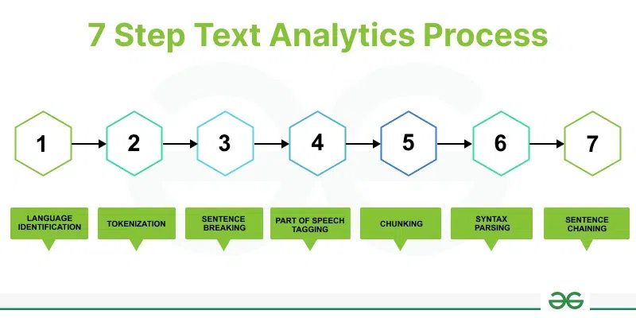
How Text Analytics Work?
Text Analytics process typically includes several key steps, such as language identification, tokenization, sentence breaking, part-of-speech tagging, chunking, syntax parsing, and sentence chaining.

Slide 13
Steps in Text Analytics
Language Identification
Objective: Determine the language in which the text is written.
How it works: Algorithms analyze patterns within the text to identify the language. This is essential for subsequent processing steps, as different languages may have different rules and structures.
Tokenization
Objective: Divide the text into individual units, often words or sub-word units (tokens).
How it works: Tokenization breaks down the text into meaningful units, making it easier to analyze and process. It involves identifying word boundaries and handling punctuation.

Slide 14
Steps in Text Analytics
Sentence Breaking
Objective: Identify and separate individual sentences in the text.
How it works: Algorithms analyze the text to determine where one sentence ends and another begins. This is crucial for tasks that require understanding the context of sentences.
Part of Speech Tagging
Objective: Assign a grammatical category (part of speech) to each token in a sentence.
How it works: Machine learning models or rule-based systems analyze the context and relationships between words to assign appropriate part-of-speech tags (e.g., noun, verb, adjective) to each token.

Slide 15
Steps in Text Analytics
Chunking
Objective: Identify and group related words (tokens) together, often based on the part-of-speech tags.
How it works: Chunking helps in identifying phrases or meaningful chunks within a sentence. This step is useful for extracting information about specific entities or relationships between words.
Syntax Parsing
Objective: Analyze the grammatical structure of sentences to understand relationships between words.
How it works: Syntax parsing involves creating a syntactic tree that represents the grammatical structure of a sentence. This tree helps in understanding the syntactic relationships and dependencies between words.

Slide 16
Steps in Text Analytics
Sentence Chaining
Objective: Connect and understand the relationships between multiple sentences.
How it works: Algorithms analyze the content and context of different sentences to establish connections or dependencies between them. This step is crucial for tasks that require a broader understanding of the text, such as summarization or document-level sentiment analysis.

Slide 17
Various Text Analytics Techniques
Sentiment Analysis: Analyzing social media comments, customer reviews, or survey responses to understand and evaluate the sentiment towards a product, brand, or service.
Customer Feedback Analysis: Extracting valuable insights from customer feedback to identify areas of improvement, track customer satisfaction, and enhance product or service offerings.
Social Media Monitoring: Monitoring and analyzing social media content to gain insights into public opinions, trends, and reactions related to a particular topic, brand, or event.
Market Research: Analyzing large volumes of textual data to identify market trends, consumer preferences, and competitive intelligence.
Email Filtering and Classification: Automatically categorizing and filtering emails based on content, helping in prioritizing and organizing incoming messages.
Content Summarization: Summarizing lengthy documents, articles, or reports to provide concise and informative summaries for quick understanding.
Chatbot Development: Implementing natural language processing to develop intelligent chatbots that can understand and respond to user queries in a human-like manner.

Slide 18
Application of Text Analysis
Legal Document Analysis: Assisting legal professionals in parsing and summarizing complex legal documents for faster comprehension.
Healthcare Data Insights: Analyzing medical records and patient feedback to derive insights for improved healthcare services and patient care.
Financial Data Evaluation: Enhancing fraud detection by scrutinizing large volumes of financial texts to identify irregularities and potential risks.
Educational Content Enhancement: Improving educational materials by analyzing student feedback and adapting content to better suit learning needs.

Slide 19
What is web analytics?
Web analytics is the process of analyzing the behavior of visitors to a website by tracking, reviewing and reporting the data generated by their use of the site and its components, such as its webpages, images and videos. The goal is to provide actionable insights that can help the site owner optimize the website for users and meet business objectives such as increased traffic, conversions or sales.
Collecting user behavioral data on a website or web application and analyzing that data for a specific purpose facilitates making decisions to achieve that purpose. Analytics tools communicate with web browsers to track and analyze online behavior, then generate results in human-readable formats like tables, charts or graphs.

Slide 20
Web Analytics
Data the tool collects may include traffic sources, referring sites, page visits or views, paths taken and conversion rates, plus other metrics such as the following:
Overall traffic to the site or app.
Bounce rate.
New visitors.
Returning visitors, or repeat visit rate.
Time spent on the site.
Monthly unique visitors.
Besides those metrics, web analytics may track customer click through and drilldown behavior and determine the sites from which customers most often arrive.

Slide 21
Who uses web analytics?
Web analytics can benefit any business or individual that owns a website or web application and needs a way to understand and optimize its performance. The collection and analysis of web analytics can reveal ways to attract more visitors, retain more customers and even increase revenues from each customer.
Web analytics are also useful for the following:
User interface or user experience designers.
Product managers.
Data scientists.
Digital analysts.
Digital marketers.
E-commerce specialists.
Content managers.

Slide 22
Importance of web analytics
Web analytics that are available in the right form and in a timely manner can help a business or individual in all these ways:
Personalize the site to repeat users or customers to enhance their site and brand experiences and capture their loyalty.
Determine the likelihood that a given customer will repurchase a product after purchasing it in the past.
Monitor the money customers (or specific groups of customers) spend to guide future strategies for sales (e.g., upsells or cross-sells) or promotions.
Observe the geographic regions from where the most and least number of customers visit and purchase specific products and use this information to guide location-specific sales or promotional strategies.
Predict which products customers are most and least likely to buy in the future and present them with recommendations most likely to yield a sale.
Track search queries that generate the maximum traffic to the site and use the data to create and optimize site content using search engine optimization (SEO) strategies.
Analyze the top referral sources to invest in advertising on the appropriate social media sites and optimize ad spend and ROI.

Slide 23
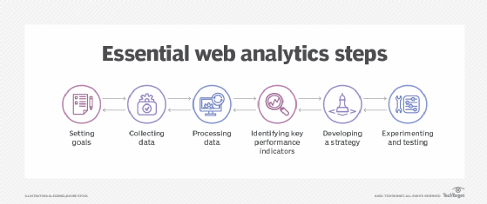
Web analytics process

Slide 24
Web analytics process
Set goals. The first step is for businesses to determine goals and results sought with web analytics such as increased sales or higher customer satisfaction and brand awareness. Some goals can be quantitative, such as increasing sales by a certain percentage, while others can be qualitative, such as enhancing customer experiences.
Collect data. The second step is to collect data with an analytics tool like Google Analytics. This data mainly comes from HTTP requests, including data at the network and application levels. It can be combined with external data like Internet Protocol addresses to interpret users' web usage and capture other relevant information about the user, such as their location and clickthrough rates.
Process data. The next stage is to process and transform the collected data into insights that facilitate decision-making.
Identify key performance indicators (KPIs). KPIs are a quantifiable measure to monitor and analyze user behavior on a website, such as page visits, traffic sources, bounce rates, unique users, user sessions and on-site search queries. They help track progress toward a specific goal.

Slide 25
Web analytics process
Develop an analytics-driven strategy. This stage involves implementing insights from web analytics to formulate strategies aligned to the organization's goals. For example, analytics about search queries can clarify what users are searching for on Google and guide content strategy development.
Experiment to validate and implement the strategy. Experimenting with different strategies can help identify one that yields the best results. With A/B testing, for example, a business creates two versions of a piece of content (e.g., an email message) to gauge the response of different audience subsets, then uses the "winning" version to send to the larger audience to optimize a sales or marketing campaign.

Slide 26
Main categories of web analytics
Off-site web analytics
Off-site web analytics involves monitoring visitor activity outside the site to measure their behaviors. The data is collected from resources across the web, such as social media, search engines and forums. It provides insights into how a business is performing against its competitors.
On-site web analytics
On-site web analytics tracks visitor activity to a specific site to gauge its performance. This data, which is usually more relevant to the site owner, can include details that demonstrate visitors' site engagement, such as popular content or pages. Two technological approaches to on-site web analytics are log file analysis and page tagging.
Log file analysis, also known as log management, is the process of analyzing data from log files to monitor, troubleshoot and report on a website's performance.
Page tagging requires adding code snippets called tags into a website's page code using a tag management system. The goal is to track site visitors and their interactions via metrics like the number of pages viewed and number of unique visitors.

Slide 27
What is Marketing Analytics?
Marketing analytics is the practice of using data to evaluate the effectiveness and success of marketing activities. Marketing analytics allows you to gather deeper consumer insights, optimize your marketing objectives, and get a better return on investment.
Marketing analytics benefits both marketers and consumers. This analysis allows marketers to achieve higher ROI on marketing investments by understanding what is successful in driving either conversions, brand awareness, or both. Analytics also ensures that consumers see a greater number of targeted, personalized ads that speak to their specific needs and interests, rather than mass communications that tend to annoy.
Marketing data can be analyzed using a variety of methods and models depending on the KPIs being measured. For example, analysis of brand awareness relies upon different data and models than analysis of conversions. Some popular analytics models and methods include:
Media Mix Models (MMM): Attribution models that look at aggregate data over a long period of time.
Multi-Touch Attribution (MTA): Attribution models that provide person-level data from across the buyer’s journey.
Unified Marketing Measurement (UMM): A form of measurement that integrates various attribution models including MMM and MTA into comprehensive engagement metrics.

Slide 28
The Importance of Marketing Analytics
In the modern marketing landscape, accurate data is more important than ever. Consumers have become highly selective in choosing the branded media they engage with and the media they ignore.
If brands want to catch the ideal buyer’s attention, they must rely on accurate data to create targeted personal ads based on individual interests, rather than broader demographic associations. This will allow marketing teams to serve the right ad, at the right time, on the right channel to move consumers down the sales funnel.

Slide 29
How Organizations Use Marketing Analytics
Product Intelligence
Product intelligence involves taking a deep dive into the brand’s products as well as analyzing how those products stack up within the market. Typically done by speaking to consumers, polling target audiences or engaging them with surveys, organizations can better understand the differentiators and competitive advantages of their products. From there, teams can better align products to the unique consumer interests and problems that help drive conversions.
Customer Trends and Preferences
Analytics can tell a lot about your consumers. What messaging / creative resonates with them? Which products are they buying and which have they researched in the past? Which ads are leading to conversions and which are ignored?
Product Development Trends
Analytics can also offer insight into the types of product features consumers want. Marketing teams can pass this information on to product development for future iterations.

Slide 30
How Organizations Use Marketing Analytics
Customer Support
Analytics also helps uncover areas of the buyer’s journey that could be simplified or improved. Where are your clients struggling? Are there ways you can simplify your product or make the check-out process easier?
Messaging and Media
Data analysis can determine where marketers choose to display messages for particular consumers. This has become especially important due to the sheer number of channels. In addition to traditional marketing channels such as print, television and broadcast, marketers must also know which digital channels and social media networks consumers prefer. Analytics answers these key questions:

Slide 31
How Organizations Use Marketing Analytics
What media should you be buying?
Which are driving the most sales?
What message is resonating with your audience?
Competition
How do your marketing efforts compare with the competition? How can you close that gap if there is one? Are there opportunities your competitors are capitalizing on that you may have missed?
Predict Future Results
If you have a thorough understanding of why a campaign worked, you’ll be able to apply that knowledge to future campaigns for increased ROI.

Slide 32
Data Types
Data is a simple record or collection of different numbers, characters, images, and others that are processed to form Information. In statistics, we have different types of data that are used to represent various information. In statistics, we analyze the data to obtain any meaningful information and thus categorizing data into different types is very important. Data types in statistics help us to make an informed decision about what type of process is used to analyze the data.

Slide 33
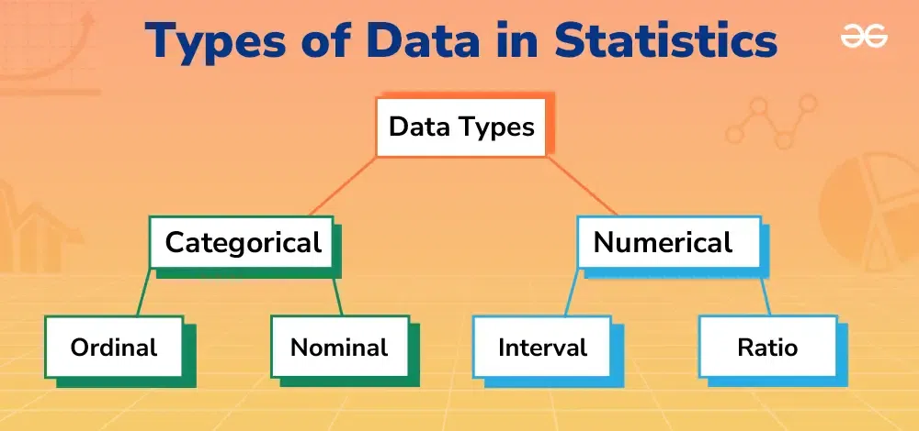
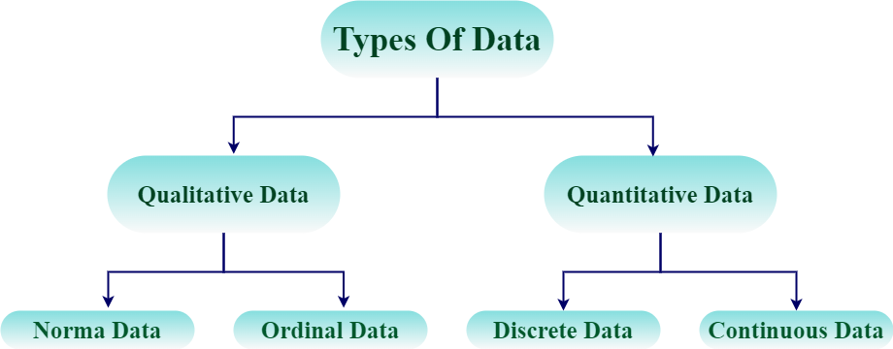

Slide 34
What is Data?
Data is defined as the collection of numbers, characters, images, and others that can arranged in some manner to form meaningful information. In statistics, the data is mainly the collection of numbers that is first studied then analyzed and presented in some way that we can get some meaningful insight from that data.
For example, 12, 19, 17, and 15 this is data.

Slide 35
What are Types of Data in Statistics?
The data in statistics is classified into four categories:
Nominal data
Ordinal data
Discrete data
Continuous data

Slide 36
Qualitative Data (Categorical Data)
As the name suggest Qualitative Data tells the features of the data in the statistics. Qualitative Data is also called Categorical Data and its categories the data into various categories. Qualitative data includes data such as gender of people, their family name and others in sample of population data.
Qualitative data is further categorized into two categories that includes,
Nominal Data
Ordinal Data

Slide 37
Nominal Data
Nominal data is a type of data that consists of categories or names that cannot be ordered or ranked. Nominal data is often used to categorize observations into groups, and the groups are not comparable. In other words, nominal data has no inherent order or ranking. Examples of nominal data include gender (Male or female), race (White, Black, Asian), religion (Hinuduism, Christianity, Islam, Judaism), and blood type (A, B, AB, O).
Nominal data can be represented using frequency tables and bar charts, which display the number or proportion of observations in each category. For example, a frequency table for gender might show the number of males and females in a sample of people.

Slide 38
Ordinal Data
Ordinal data is a type of data that consists of categories that can be ordered or ranked. However, the distance between categories is not necessarily equal. Ordinal data is often used to measure subjective attributes or opinions, where there is a natural order to the responses. Examples of ordinal data include education level (Elementary, Middle, High School, College), job position (Manager, Supervisor, Employee), etc.
Ordinal data can be represented using bar charts, line charts. These displays show the order or ranking of the categories, but they do not imply that the distances between categories are equal.

Slide 39
Quantitative Data (Numerical Data)
Quantitative Data is the type of the data that represents the numerical value of the data. They are also called the Numerical Data. This data type is used to represent the height, weight, length and other things of the data. Quantitative data is further classified into two categories that are,
Discrete Data
Continuous Data

Slide 40
Discrete Data
Discrete data type is a type of data in statistics that only uses Discrete Value or Single Values. These data types have values that can be easily counted as whole numbers. The example of the discrete data types are,
Height of Students in a class
Marks of the students in a class test
Weight of different members of a family, etc.
Continuous Data
Continuous data is the type of the quantitative data that represent the data in a continuous range. The variable in the data set can have any value between the range of the data set. Examples of the continuous data types are,
Temperature Range
Salary range of Workers in a Factory, etc.

Slide 41
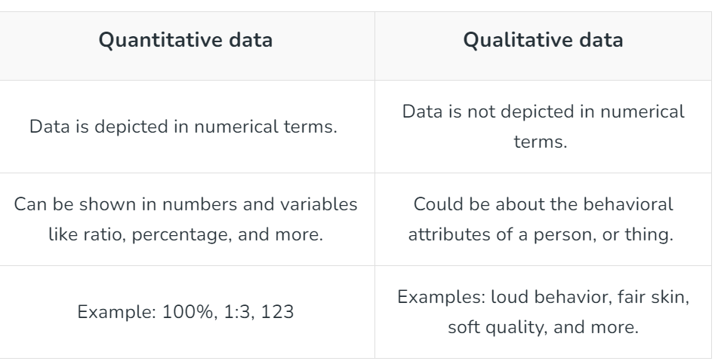
Difference between Quantitative and Qualitative Data

Slide 42
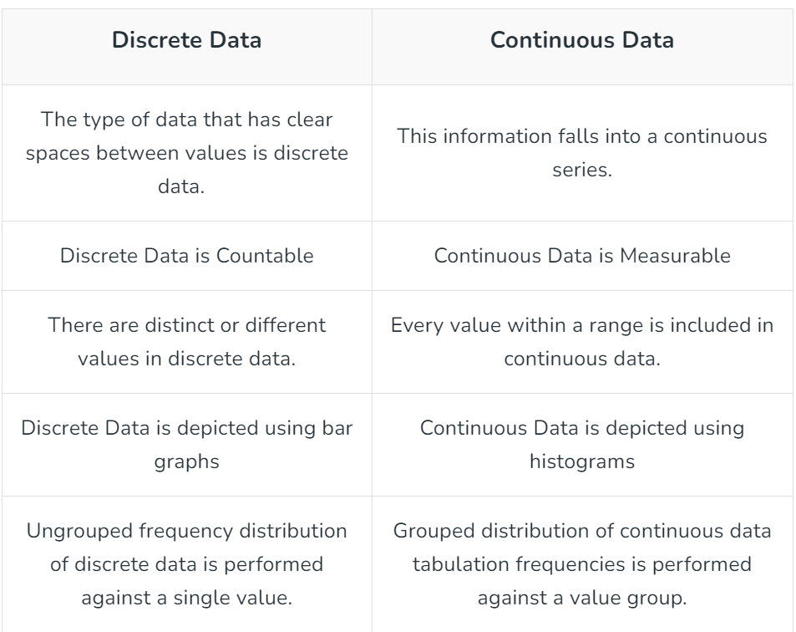
Difference between Discrete and Continuous Data

Slide 43
Difference between Structured, Semi-structured and Unstructured data
Big Data includes huge volume, high velocity, and extensible variety of data. There are 3 types: Structured data, Semi-structured data, and Unstructured data.
Structured data – Structured data is data whose elements are addressable for effective analysis. It has been organized into a formatted repository that is typically a database. It concerns all data which can be stored in database SQL in a table with rows and columns. They have relational keys and can easily be mapped into pre-designed fields. Today, those data are most processed in the development and simplest way to manage information. Example: Relational data.

Slide 44
Difference between Structured, Semi-structured and Unstructured data
Semi-Structured data – Semi-structured data is information that does not reside in a relational database but that has some organizational properties that make it easier to analyze. With some processes, you can store them in the relation database (it could be very hard for some kind of semi-structured data), but Semi-structured exist to ease space. Example: XML data.
Unstructured data – Unstructured data is a data which is not organized in a predefined manner or does not have a predefined data model, thus it is not a good fit for a mainstream relational database. So for Unstructured data, there are alternative platforms for storing and managing, it is increasingly prevalent in IT systems and is used by organizations in a variety of business intelligence and analytics applications. Example: Word, PDF, Text, Media logs.

Slide 45
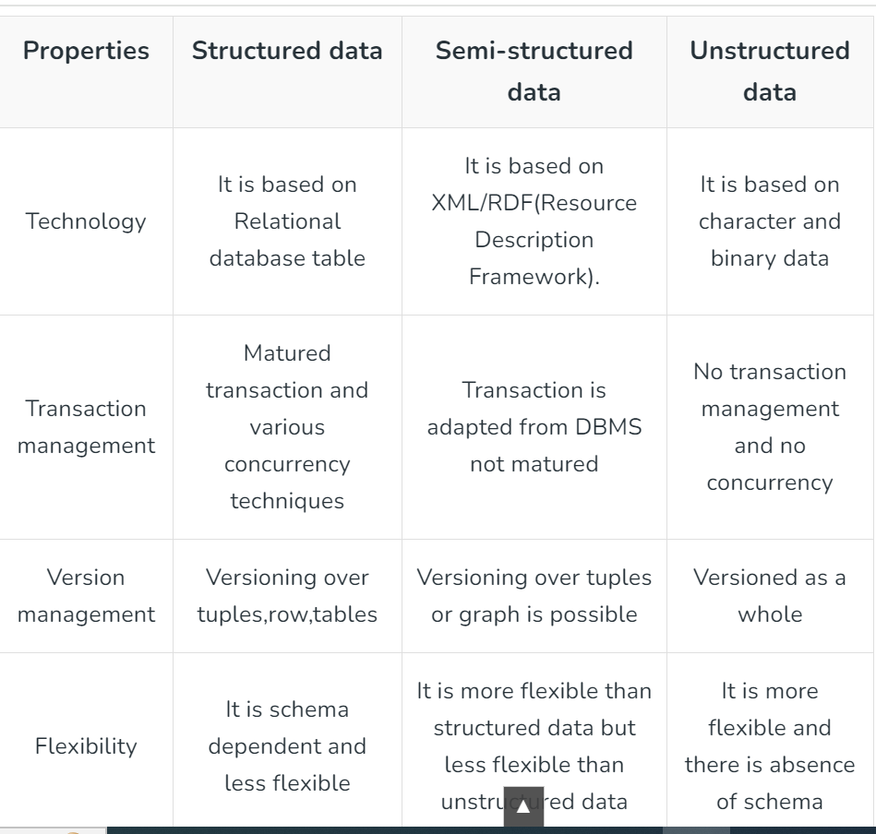

Slide 46
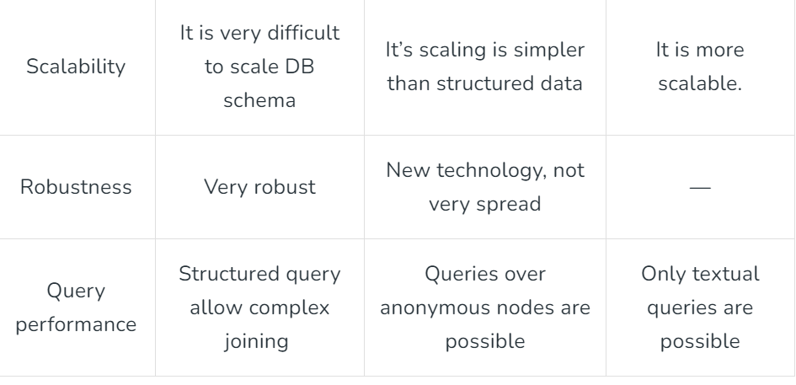

Slide 47
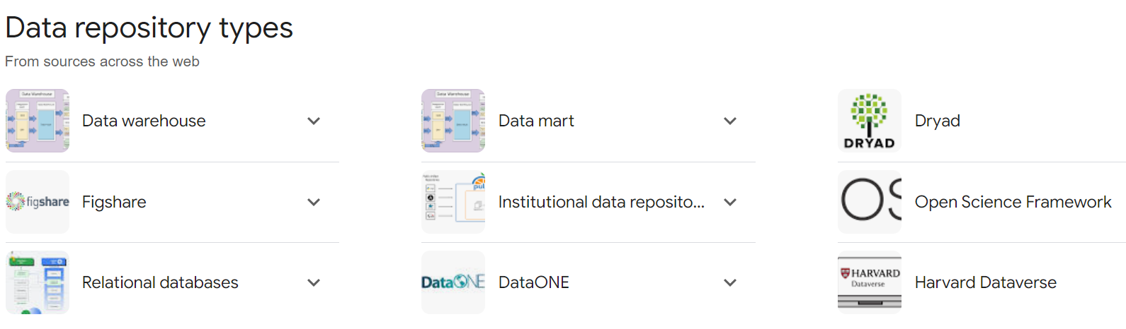
Data Repositories

Slide 48
What is a data repository?
A data repository is a data library or archive(collection of historical documents). It may refer to large database management systems or several databases that collect, manage, and store sensitive data sets for data analysis, sharing, and reporting.
Authorized users can easily access and retrieve data using query and search tools, which helps with research and decision-making. Combining data from different sources, like databases, apps, and external systems, gives a complete and unified view of the data.
Data can be collected and stored in different ways, like aggregated data, usually collected from multiple sources or segments of a business. It can then be stored structured or unstructured and later tagged with different metadata.
The data repository uses structured organization methods, standardized schemas, and metadata to ensure the data is always the same and easy to find. It has tools for storing, managing, and protecting data, such as compression, indexing, access controls, encryption, and reporting.

Slide 49
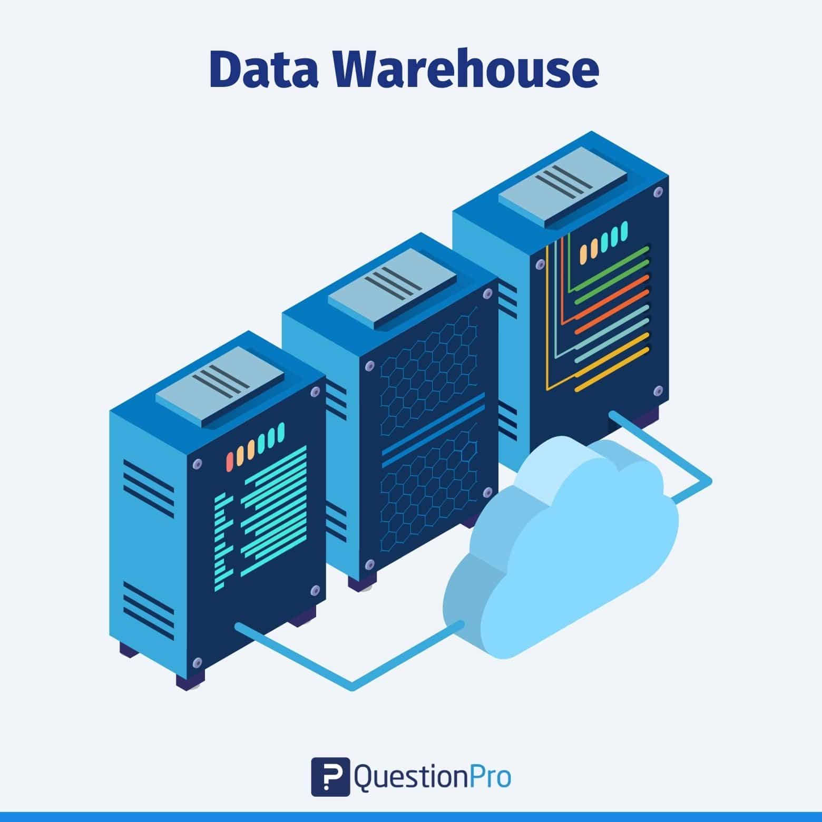
1. Data warehouse
This is the largest repository type, where data is collected from several business segments or sources. The data stored in this repository is generally used for analysis and reporting, which will help the data users or teams make the correct decisions in their business or project.

Slide 50
2.Data lake
In this type of repository, data can be in any form, whether structured, semi-structured, or unstructured. It is a huge storehouse of unstructured data categorized and labeled with metadata.
The main reason for a data lake is the limitation of the data warehouses. It helps to gain better data governance and data governance framework total control of the data it has in it.

Slide 51
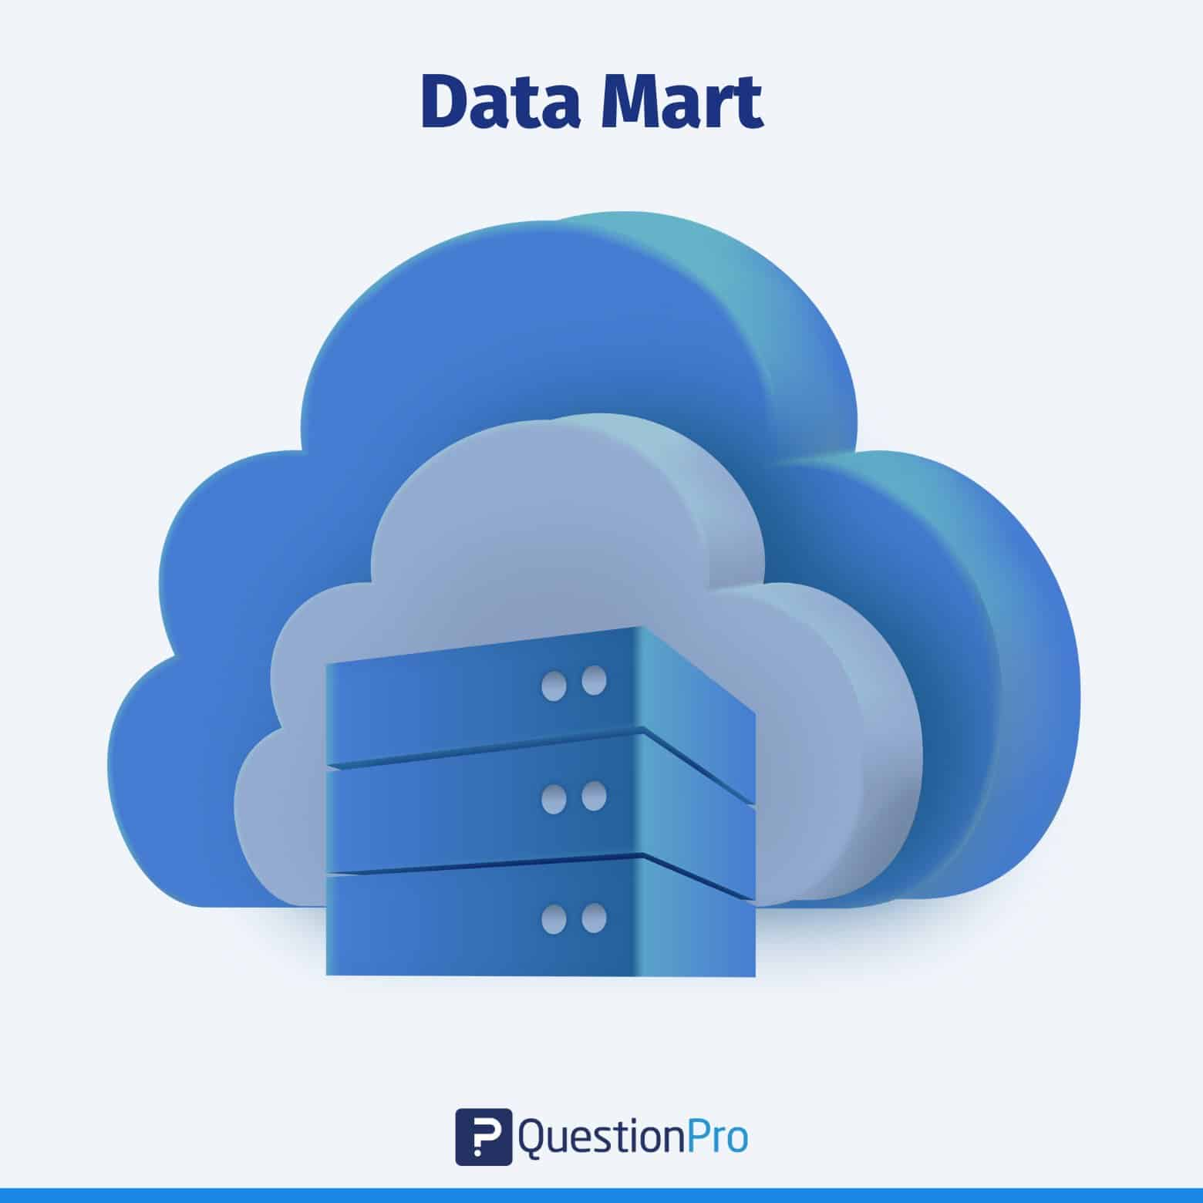
3. Data mart
Data marts are often confused with data warehouses. However, they serve different functions.
This subset of the data warehouse is focused on a particular subject, department, or other specific area.
Since the data is stored for a specific area, a user can swiftly access the insights without spending much time searching an entire data warehouse, ultimately making users’ lives easy.

Slide 52
4.Data cube
This repository contains the most complex data in it. It may be described as the multidimensional extensions of different tables, and they’re generally used to represent data that is too complex to be described by just tables, rows, and columns.
So basically, a data cube can be used when we analyze data available to us and beyond 3-D.

Slide 53
5. Data Pipelines
Let’s say you run a large online bookstore. It’s open 24/7. Users may place orders and pay for them literally every minute or second. That means your website must quickly process lots of transactions involving small amounts of data like order ID and details, user ID, or credit card data. Online transaction processing (OLTP) systems, namely databases and applications like a shopping cart, make it possible for an eCommerce business to work nonstop as it must. Besides running daily operations, you may evaluate your performance. For instance, analyze sales for a given book or author during the previous month. It means you must collect transactional data and move it from the database that supports transactions to another system that can handle large volumes of data. And, as is common, to transform it before loading to another storage system. Only after these actions can you analyze data with dedicated software (a so-called online analytical processing or OLAP system). But how do you move data? You need infrastructure, hardware and/or software, that will allow you to do that. You need an efficient data pipeline.

Slide 54
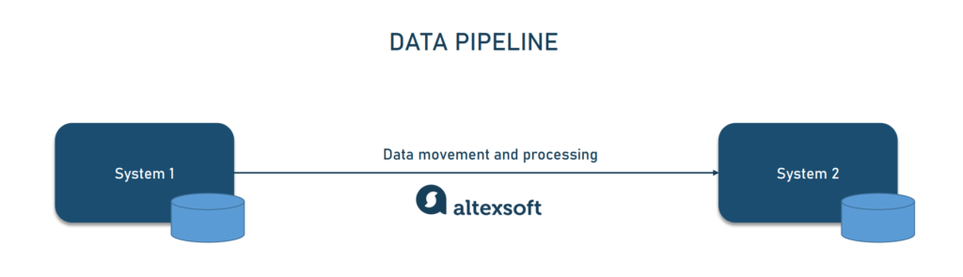
What is a data pipeline?
A data pipeline is a set of tools and activities for moving data from one system with its method of data storage and processing to another system in which it can be stored and managed differently. Moreover, pipelines allow for automatically getting information from many disparate sources, then transforming and consolidating it in one high-performing data storage.

Slide 55
5.Data Pipeline
Imagine that you’re gathering various data that shows how people engage with your brand. That can be their location, device, session recordings, purchase and customer service interaction history, feedback shared, and more. And then you place these pieces of information in one place, a warehouse, creating a profile for each customer. Thanks to data consolidation, everyone who uses data to make strategic and operational decisions or build and maintain analytical tools, can easily and quickly access it. These can be data science teams, data analysts, BI developers, chief product officers, marketers, or any other specialists that rely on data in their work.

Slide 56
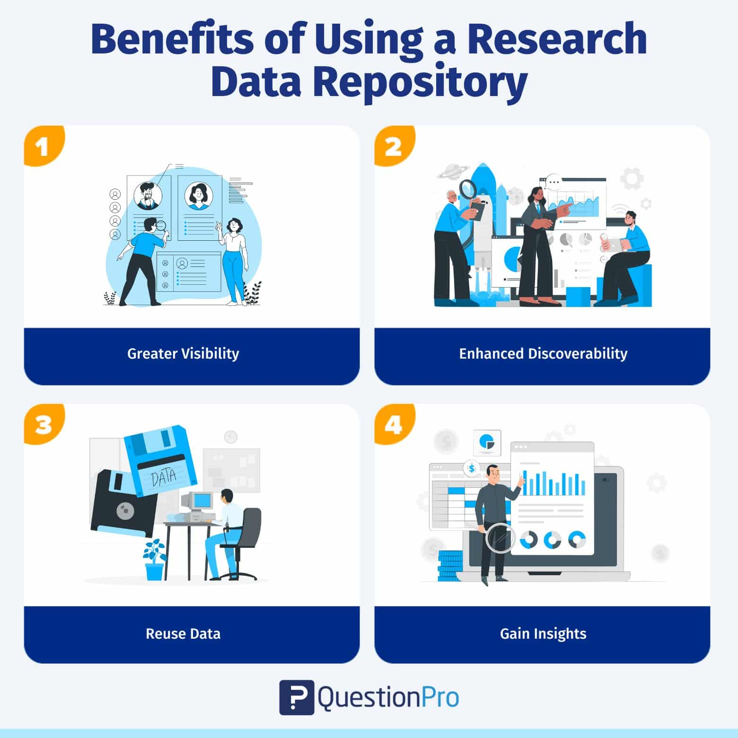

Slide 57
Benefits of using Data Repositories
Greater visibility
Data saved in data repositories can be viewed anytime. Keeping it siloed( in Excel sheets or applications not used by a team reduces its visibility and usability, wasting time and resources.
2. Enhanced discoverability
Saving data in digital format makes it more accessible. Just search for the piece of data you’re looking for, and voila! The metadata added to the data repository enables others to understand and make more sense of the large context.
3. Reuse data
A data repository contains many pieces of data. However, it’s more than just a warehouse. Discrete datasets are joined so that you can derive interesting insights into your area of research and generate various types of reports using the same datasets.
Gain insights from multiple sources of data
Integrating data repositories with other applications lets you see a multi-dimensional view of your data. For instance, you can analyze the historical survey data and the actual sales data to understand the accuracy of insights gained in the past.

